Slide 1

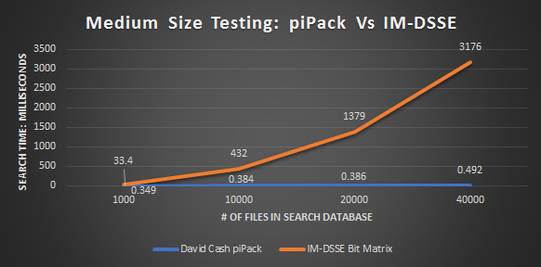
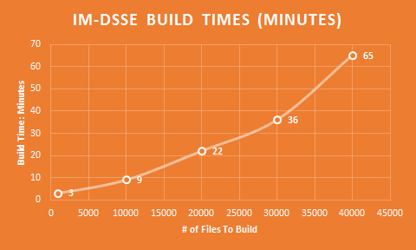
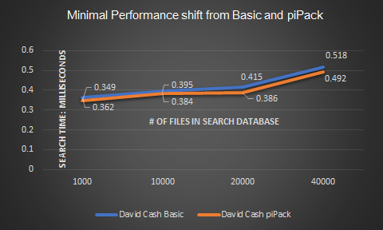
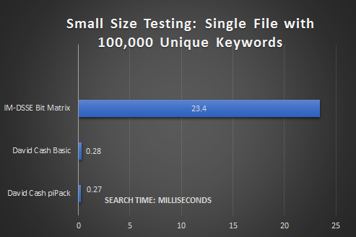

CS38
Symmetric Searchable Encryption (SSE): provides functions to create, search, add, and delete documents in an encrypted index.
PRIVACY-PRESERVING CLOUD & EMAIL ENCRYPTION
The Secret Bunny Team
Motivation
Conclusion
Storage service offered by cloud providers bring vast benefits to human society. However, this service also brings privacy concerns to users.
While the data privacy can be preserved by using standard encryption, it also prevents the user from querying the data on the cloud and thereby, invalidating the benefit of using cloud services.
Thus, there is a need to develop a new cryptographic primitive that allows the user to query data outsourced to the cloud, while preserving its privacy.
Andrew Ekstedt, Scott Merrill, Scott Russell Sponsored by: Attila Yavuz with Thang Hoang
Searchable encryption preserves privacy by preventing the server from learning anything about the stored documents or the user’s search queries.
Our benchmarks show that Cash-DSSE performs well and easily scales up to large data sets, returning results in mere milliseconds. We think searchable encryption could potentially be deployed in consumer cloud applications.
BENCHMARKING DATA
References
Algorithm Comparison
Medium Dataset testing from 1000-40000 files.
It becomes very expensive to build IM-DSSE locally as file size increases.
D. Cash, J. Jaeger, S. Jarecki, C. Jutla, H. Krawczyk, M.-C. Rou, and M. Steiner, “Dynamic searchable encryption in very-large databases: Data structures and implementation,” Cryptology ePrint Archive, Report 2014/853, 2014. [Online]. Available: https://eprint.iacr.org/2014/853
A. A. Yavuz and J. Guajardo, “Dynamic searchable symmetric encryption with minimal leakage and efficient updates on commodity hardware,” Selected Areas in Cryptography (SAC) 2015, Sackville, New Brunswick, Canada, August 2015, http://web.engr.oregonstate. edu/∼yavuza/Yavuz DSSE SAC2015.pdf.
“Libtomcrypt.” [Online]. Available: http://www.libtom.net/LibTomCrypt/
T. Hoang, “IM-DSSE: Dynamic Searchable Symmetric Encryption with Incidence Matrix (IM),” 2017. [Online]. Available: https://github.com/thanghoang/IM-DSSE
IM-DSSE Bit Matrix:
Files and keywords are built into a 2-D Bit Matrix designed to be both an efficient and space-saving DSSE scheme.
David Cash Basic:
A key-value pair data structure which maps the files and the words they contains into a database.
David Cash piPack:
An expansion of the David Cash Basic which compacts multiple files into the key-value pair to improve efficiency.
Comparison of Basic Cash scheme vs piPack, there is limited overhead involved between the two.
Small testing has very limited overhead for both forms of David Cash’s scheme relative to IM-DSSE
METRICS
ALGORITHMS
Unique Keyword Search: How long a search request takes to fulfill from the time it leaves the client to the time the server responds. (Data collected from 100 aggregated runs)
Build Time: We also looked how long it took to build IM-DSSE at differing database file sizes.
Cash-DSSE: Designed by David Cash. [1]. It stores the encrypted index in a hash table-like structure. We implemented this algorithm in C++ with the libtomcrypt library [3].
IM-DSSE: Designed by Attila Yavuz [2], and previously implemented by Thang Hoang [4]. It represents the encrypted index as a Bit Matrix.
Scott Russell, Scott Merrill, Andrew Ekstedt
(From left to right)
Software testing completed on two systems: (aggregate data take from averages of both)
1: MacBook Pro (15-inch, Early 2011) Processor 2.2 GHz Intel Core i7 8 GB 1333 MHz DDR3
2. Dell Inspiron 15-3567
Intel Core I3-6006U
2.00GHZ
4.0 GB Ram
Windows 10

